Slide 1
Arduino Workshop
By
Devansh Srivastava
ISRO Intern, hG Joint Secretary, IEEE SB Chairman

Slide 2
What is Arduino?
A company manufacturing open-source micro-controllers.
Some of the famous boards are Arduino Uno R3, Arduino NANO, Arduino MEGA, Arduino Leonardo etc.

Slide 3
What is Micro-controller?
A computer on chip.
Components of Micro-controllers-
1- Micro-processor
2- Input/Output Interfacing Ports
3- Communication Channels
4- Memory(RAM/ROM)
5- Power pins/plugs

Slide 4
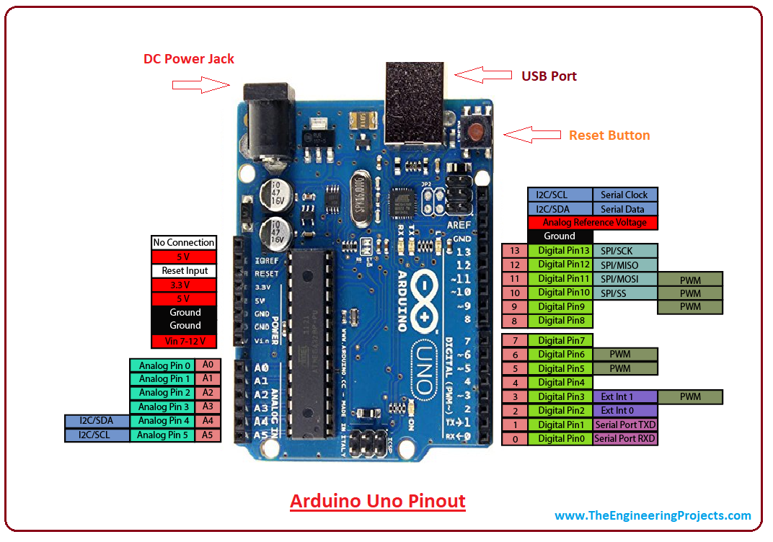

Slide 5
Features of Arduino UNO R3

Slide 6
Overview
Processor- ATmega 328P
14 digital i/o pins and 6 analog i/o pins
16MHz ceramic resonator
USB jack, AC-to-DC power adapter and Power Pins
Supports Arduino IDE for programming.

Slide 7
Technical Specs
Operating Voltage- 5V (input voltage can be 6V-20V)
DC current per I/O pin- 20mA
Flash Memory- 32kB
SRAM- 2kB
EEPROM- 1kB

Slide 8
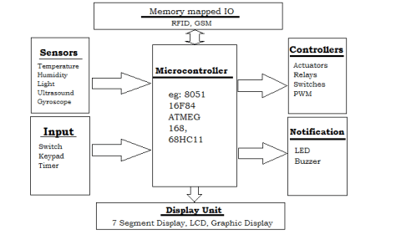
Embedded System Hardware Architecture
Embedded System Hardware Architecture

Slide 9
Sensors
Used to read the stimulus of the environment
Analogous to eye/ear/tongue/skin of the Human body
Some of the popularly used sensors are-
1- Ultraviolet Sensor
2- Infrared Sensor, PIR Sensor
3- Axis Sensor, Gyroscope, Accelerometer
4- Flex Sensor

Slide 10
Actuators
Used to perform the action that we want the ES to do
Analogous to hand/leg/throat of the human body
Some of the widely used actuators are-
1- DC,AC and Stepper Motors
2- LED and LCD Module
3- Speaker

Slide 11
Arduino Programming

Slide 12
Arduino Programming is very similar to C. All the rules of C is applicable in Arduino IDE.
IDE editor has two inbuilt functions- void setup() and void loop()
void setup() is used to configure the input/output ports and initialize the Terminal Window generally.
void loop() contains the main body of the code that has to run for infinite times

Slide 13
Some inbuilt functions
digitalWrite( pinnumber, ACTION )- used to produce digital outputs at any output port. ACTION can be either HIGH or LOW
digitalRead(pinnumber)- used to intake digital inputs at any input port
Serial.begin(‘baudrate’)- initializes the terminal window
Serial.println(“message”)- prints and change the line in terminal window
delay(‘time in milliseconds’)- produces delay of given amount
pinMode(pinnumber, Mode)- defines the character of pin

Slide 14
Some inbuilt functions
analogRead( pinnumber )- used to intake analog inputs at any analog port. In Arduino UNO, there is a 10-bit Analog to Digital Converter that maps 0-5V to 0-1023 value.
analogWrite(pinnumber, value)- used to output analog outputs at any analog port. Value lies in the range 0-255 depending on the duty cycle of PWM output.

Slide 15
Blinking a LED

Slide 16
Light LED using Potentiometer and Arduino

Slide 17
QnA

